Slide 1
Disks used for:
  Permanent storage of data and programs
  Distributing data from one computer to another
  Making copies
Partitioning is creating logical units of space on a drive, dividing the drive in one or more parts, and deciding how much space will be allocated to each part of the drive.
You can use all drive as one partition, you can create multiple equally sized parts, multiple partitions, or create smaller and bigger parts of the drive, have several partitions of different sizes.

Slide 2
If the partition is to be used to hold files, it needs a file system to manage the file infrastructure (keeping track of the pieces, providing a directory structure, holding metadata about the file characteristics, permissions, etc.).
Formatting creates the file system inside the partition.

Slide 3
Formatting is process of creating file systems on those drive parts, and deciding which file system will be on which part
  it is not deciding how much space to use but what type of addressing table is that partition going to use
  size is determined during partitioning, and file system will fill the whole partition, when it is created.
You can for example divide a single drive in two parts, and then format one part of the drive as ntfs, to install Windows on it, while you format a second part of the drive as ext4 for example, and install Linux on it.

Slide 4
You can't put two different file systems on one partition, you need to have a partition for each file system.
You can have a scenario in which a partition is not fully filled with a file system, but in that case partition was expanded after the file system was created, or file-system shrinked after initial creation
  You need to expand the file system to fill up the empty space, or reduce the partition to free empty space for different partition
  Empty space can't be used for a different file system, unless you remove it from a partition, and add it to some other partition.

Slide 5
File system lies on top of the partition, partition is a container for file system
When you resize partitions or file systems you always need to first expand/shrink one, before doing the same to the second.
If you want to expand a file system, you first need to expand the partition, before you expand the file system, and when you want to reduce partition size, you need to first reduce the file system size, before reducing partition size.

Slide 6
Partitioning this is simply a virtual division of a drive or disk into two or more volumes and defining how much space can be allocated to a particular volume of space within that drive.
Formatting, in short, can be defined as a the preparation of a drive for initial use, hence stating its file system.
Formatting refers to an initialization operation performed to disk to make it available for data storage.
The implication is that if a disk has not been formatted yet, it can’t be used to save data.

Slide 7
Disk formatting is the process of preparing a data storage device such as a hard disk drive, solid-state drive, floppy disk or USB flash drive for initial use
When you want to format a hard drive, for instance, to install a new operating system or dispose of the computer the drive is in, there are two different methods used.
It is important to understand the differences between the two in order to ensure your data is not recoverable.

Slide 8
Parts of FORMATTING
LOW LEVEL Formatting
Partitioning
HIGH LEVEL Formatting

Slide 9
LOW LEVEL FORMATTING
Low-level formatting is the process of marking out cylinders and tracks for a blank hard disk, and then dividing tracks into multiple sectors with sector markers.
So, this process is actually a kind of physical formatting.
And it is now often performed by hard disk manufacturers.
Typically this involved subdividing each track on the disk into one or more blocks which would contain the user data and associated control information.
Low-level formatting was generally done by an operating system- system utility.

Slide 10
Low-level formatting was used to refer to the operation of dividing cylinders, tracks, and sectors.
But currently, this kind of formatting generally refers to the zero-fill operation of the hard drive.
Strictly speaking, the low-level formatting includes the following steps:
  Divide a disk into several cylinders and tracks.
  Divide each track into several sectors.
  Divide each sector into several parts, such as identification section, GAP area, and DATA

Slide 11
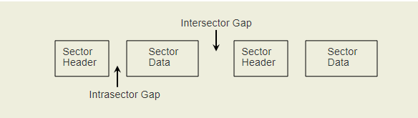
Each sector begins with a sector header containing the sector address and an error detection code for the contents of that sector.
The sector header is followed by a small intra-sector gap, followed in turn by the sector data.
Each sector is separated from the next sector by a larger inter-sector gap.

Slide 12
LLF (Low-level Format) of the hard drive is also known as “zero-filled” since it erases all the data from the storage and would replace it with zero-state bits.
It will reset the state and the content of your hard disk by restoring it to its initial/factory state.

Slide 13
When low-level formatting is required?
Low-level formatting work has been performed to each hard drive by manufacturers when it leaves the factory, so usually, users don't need to do such a thing.
Low-level formatting is a loss operation, which has a negative impact on the service life of the hard drive.
As a result, lots of manufacturers recommend that this kind of formatting should be your last resort unless your encounter the following situations:
  A hard drive is badly corrupted that the operating system cannot recover it.
  You need to get rid of almost any data-related problem on the drive (such as viruses and corrupted partitions).
  It is necessary to hide bad sectors by telling the drive to remap them to its collection of spares.

Slide 14
How to perform low-level formatting?
There are 3 ways to perform low-level formatting.
  The CMOS of many motherboards provides the low-level formatting function and it is usually embedded in HDD Low Level Format option.
    If you have this option on your motherboard, you can directly choose Hard Disk Low Level Format Utility for low-level formatting.
  Make use of the hard drive management/low-level formatting program provided by your hard drive manufacturers.
  If your hard drive is a standard one, you can also turn to third-party tools when low-level formatting is needed.

Slide 15
If users perform low-level formatting when data have been installed, all existing files will be erased, and it is almost impossible to recover them.
Therefore, some users make such a format to avoid privacy leakage.
Nevertheless, performing low-level formatting will cause damage to hard disk and shorten its service life.
Therefore, this formatting is not suggested for users.

Slide 16
PARTITIONING
Partitioning is the process of dividing a disk into one or more regions, the so called partitions.
Disk partitioning can be operated by users and it will affect the disk performance.
Partitioning is the process of writing information into blocks of a storage device or medium that allows access by an operating system.

Slide 17
HIGH LEVEL FORMATTING
It is the process of setting up an empty file system on a disk partition
HIGH LEVEL FORMATTING sometimes referred to as quick formatting.
High level formatting can be performed on a hard disk only after the sectors and tracks have been formatted using a low level format
This type of formatting is where actual data, like the operating system is written onto the drive sectors to create file and system structures so you can use the drive to install other applications and store data and files.

Slide 18
High-level formatting is the process of writing a file system, cluster size, partition label, and so on for a newly created partition or volume.
It is typically done to erase the hard disk and reinstall the operating system back onto the disk drive.
High-level formatting will clear data on hard disk, generate boot information, initialize FAT, and label logical bad sectors when the partition has existed.
Formatting hard disk usually done by user is the high-level formatting.

Slide 19
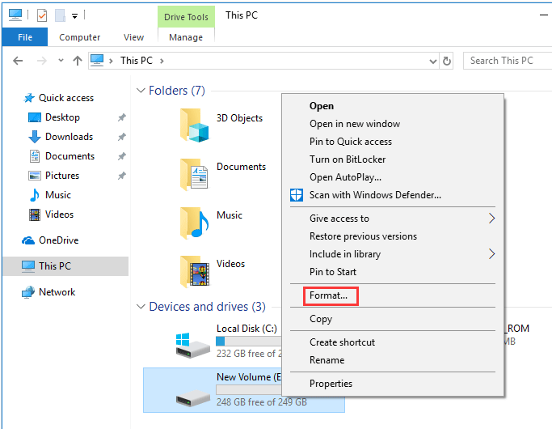
This formatting process does no harm to hard disk in general situations
It can be done very easily with Administrator, Windows snap-in Disk Management tool, diskpart, etc.
We can take such a format to fix some problems, for example, incompatible file system error and problem like that the hard drive is corrupted or develops bad sectors.

Slide 20
High-level formatting includes the following steps:
Rewrite the corresponding region of the partition table in Master Boot Record (mbr)
Divide certain disk partition space to store information that is used for file management (such as file allocation table and file directory table, according to users’ selection on the file system)
In other words, high-level formatting refers to removing data on hard drive, generating boot sector information, initializing FAT and marking logical bad sectors.
This kind of formatting is generally involved in the OS reinstallation process.
Since MBR is not going to be rewritten, there is a great possibility that virus exists. But don’t worry, the MBR virus can be completely cleared by using antivirus software or executing fdisk/mbr in DOS.

Slide 21
When high-level formatting is required?
Initialize drive: a new disk drive can’t be put into use before formatting. So if users want to use a new drive to store and manage data, they need to format it.
Kill virus: If users want to kill the virus in certain drive and make it clean, they’d better format the drive rather than just using antivirus software.
Change file system/drive size: once a drive is set, its file system and size are determined. When users need to change any of them, they have to format the drive again.
Format inaccessible drive: the commonest case is that users open a drive, only to find it can’t be accessed. To further use it, users have no choice but to format this drive.

Slide 22
How to perform high-level formatting?
There are also 3 common ways to format a drive in Windows.
Format with Partition Wizard
Format in Windows Explorer
  click on the “Computer” icon on the desktop to enter.
  select the drive you plan to format. Afterwards, right click on it and choose “Format…” from the pop-up menu
Format in Windows Disk Management
  open Computer Management and choose “Disk Management” under “Storage”.
  right click on the unallocated space and choose “New Simple Volume…” to start. Then, click “Next” in each interface of “New Simple Volume Wizard” to continue. In this process, you are allowed to set volume size, drive letter, file system, allocation unit size, and volume label. At last, click “Finish”.

Slide 23
 | High-Level Formatting | Low-Level Formatting
Feature | Clear data, delete marks. Check sectors. Initialize boot information. Initialize partition table information. | Media check. Disk media test. Divide tracks and sectors. Number each sector (C/H/S). Fix some logic bad sectors.
Pros | Quickly clean up existing data. Won't cause physical damage to the hard drive, external hard drive, USB, or SD card. | Low-level format an entire disk at one time.
Cons | Can't fix bad sectors. Can't complete the format if a drive contains too many bad sectors or other errors. | Cause physical damage to hard disk drives when the disk contains bad sectors. Slow to execute low-level format on hard drives. For example, it would last 20+ hours in low-level formatting a 320GB disk.

Slide 24
Is Reformatting Partitions without Data Loss Possible?
Generally, if users perform high-level formatting on partitions with data saved, all these data will be lost.
However, nowadays, many users hope to reformat an existing partition in Windows without data loss.
Actually, this is impossible.
But computer users can make a backup in advance before formatting.

Slide 25
Besides, if users want to just convert file system, change partition label, or change cluster size without loss so as to fix some problems, MiniTool Partition Wizard can help them.
Convert FAT to NTFS to achieve the following purposes:
  Handle large files (over 4GB).
  Get better stability, higher security and lesser defragmentation time.

Slide 26
Cluster is the smallest logical unit of disk space that can be allocated to hold and manage a file in Windows operating systems.
One cluster can only hold one file, but one file can take up multiple clusters.
If users save large files to file system with small clusters, data read-write speed will be reduced.
If they save small files to file system with large clusters, a lot of disk space will be wasted.
Therefore, it is very necessary to change cluster size reasonably,

Slide 27
Recovery of Data from a Formatted Disk
As we all know, it's easy for us to format a hard disk drive and this operation will erase data on hard disk.
Then, what should we do if the hard disk or partition with important data saved is mistakenly formatted?
It is impossible to recover data from a disk on which the low-level formatting is performed.
But fortunately, there is still a possibility of successfully recovering data after high-level formatting is performed

